Slide 1
Adidas
The objective of the project was to analyze the dataset to gain insights into various aspects of Adidas sales

Slide 2
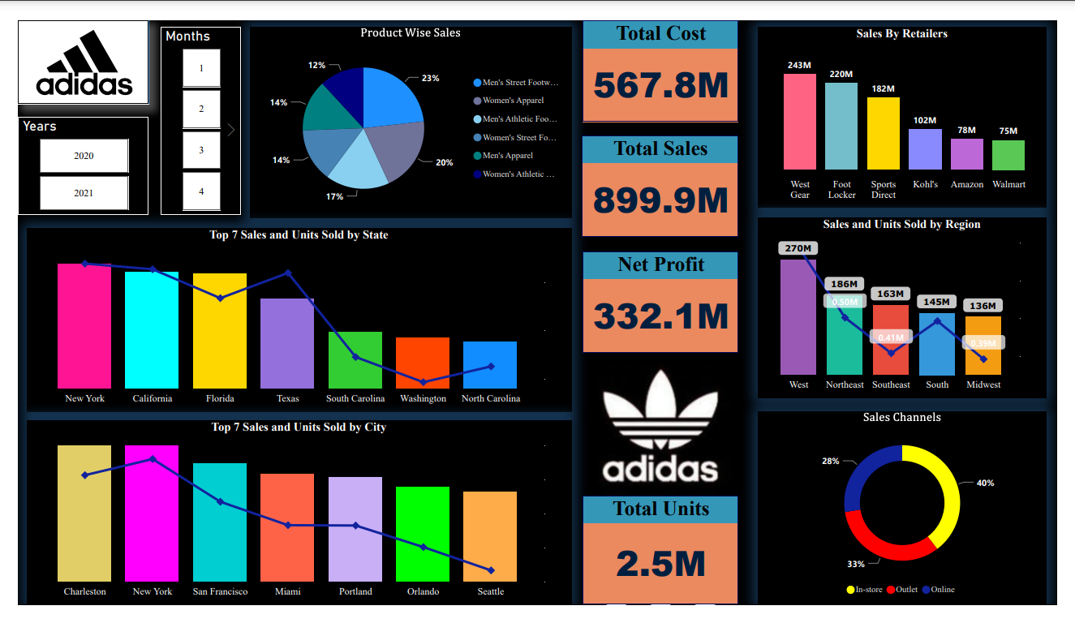
Introduction
Welcome to the analysis of the Adidas sales dataset, where we find precious insights into sales trends, performance, and marketplace dynamics. In this presentation, we can explore the key elements driving Adidas's sales success and perceive areas of possibility for further increase. Via reading this dataset, we aim to offer actionable insights which could tell strategic decision-making and force enterprise performance.

Slide 3
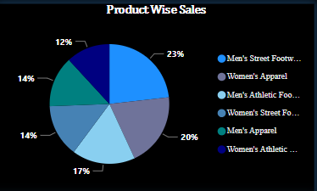
Product Wise Sales
The pie chart visually showcases the distribution of sales "Product Wise", offering treasured insights into the relative weightage of each product class.
The sales distribution in the Adidas dataset reveals that Men's Street holds the highest share (23%), followed closely by Women's Apparel (20%) and Men's Athletic (17%). Women's Street, Men's Apparel, and Women's Athletic categories also contribute significantly (14% each).

Slide 4
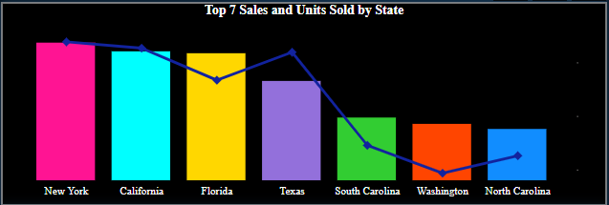
Top 7 Sales and Units Sold by State
This chart visualizes Adidas' sales across states, highlighting key regions driving sales and market penetration, and providing valuable insights into their market reach.
The top 7 states with the very best sales and units sold for Adidas products are New York, California, Florida, Texas, South Carolina, Washington, and North Carolina, reflecting robust demand and recognition across those areas.

Slide 5
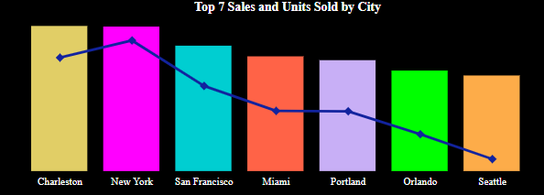
Top 7 Sales and Units Sold by City
This ranking exhibits the pinnacle 7 towns for Adidas income and units sold, with New York securing the coveted Rank 1 position.
New York leads the pack as the city with the highest sales and units sold, followed by San Francisco, Miami, and others, highlighting their contribution to Adidas' market success.

Slide 6
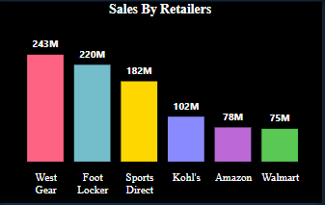
Sales By Retailers
This analysis unveils the retail landscape, West Gear conquers the sales realm with an impressive lead, followed closely by Foot Locker.
West Gear emerges as the leading retailer with the highest sales, followed by Foot Locker, Sports Direct, Kobl's, Amazon, and Walmart, reflecting their pivotal roles.

Slide 7
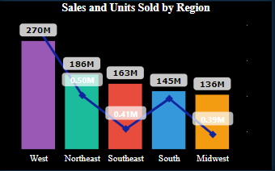
Sales and Units Sold by Region
The West takes the lead, trailed by the Northeast, Southeast, South, and Midwest.
In the west region, the percentage is high in each sale and unit bought, the Northeast follows closely in the back, even as the Southeast, South, and Midwest regions contribute to Adidas' terrific national overall performance.

Slide 8
CONCLUSION
In conclusion, the Adidas dataset uncovers captivating sales trends. Men's Street, Women's Apparel, and Men's Athletic dominate, while Women's Street, Men's Apparel, and Women's Athletic show significant potential.
New York, California, Florida, Texas, South Carolina, Washington, and North Carolina rise as hotspots, ready to focus on promoting and extending methodologies.
The big apple, California, Florida, Texas, South Carolina, Washington, and North Carolina turn out to be hotspots, ripe for centered marketing and enlargement strategies.
West Equip takes the lead among retailers, but collaborations with Foot Locker, Sports Coordinate, Kobl's, Amazon, and Walmart offer undiscovered potential for more extensive reach.
To move forward execution in underperforming regions, customized approaches are key. Analyzing client inclinations, lifting brand permeability, and actualizing localized promoting campaigns will impel Adidas to capture more of the Northeast, Southeast, South, and Midwest markets. This custom-fitted technique guarantees across-the-nation victory and proceeded deals development.

Slide 9
THANK YOU

